Slide 1











Group 4
2023

Slide 2



What is Canva ?
2023
Canva is a graphic design platform that allows users to create various types of visuals. Canva makes it easy to create without requiring in-depth knowledge of design or complex design software. Canva is one of the most popular and widely used graphic design platforms."
01

Slide 3



Promotional and Marketing Materials
02
Social Media Content
Logo Design
What is Canva used for ?
It is used for creating social media posts, profile covers, illustration, that can be used on social media platforms such as Twitter, Instagram, Facebook, LinkedIn etc.
Canva provides tools and templates for designing company or personal logos.
Canva usually used to create brochures, posters, phamphlets, banners, cards and promotional materials.

Slide 4


03
What is Canva used for ?
Greeting Cards and Invitations
Merchandise Design
Educational Materials
Canva allows you to design greeting cards, invitations, birthday cards, or other types of cards.
If you want to create custom merchandise like t-shirts, mugs, or stickers, Canva can help you design the artwork for it.
Canva can be used by educators to create engaging teaching materials such as presentations, infographics, and online learning materials.

Slide 5

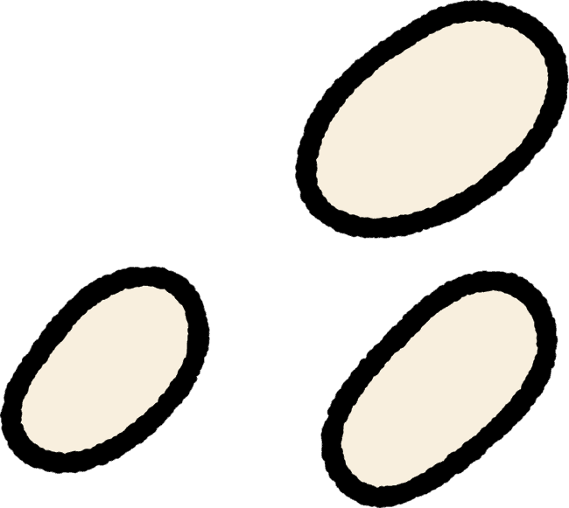




Group 4
Unit 3
04
How to make
Power Point -------

Slide 6


Group 4
Unit 3
05
First, open your web browser and type canva.com

Slide 7
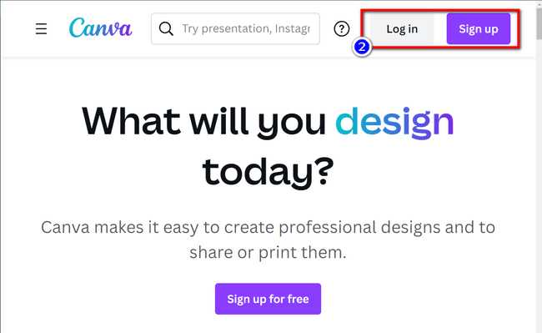
Group 4
Unit 3
06
Next, Account login is required if one already exists.
If there is no existing account, registration for a Canva account is possible using your email address, or login via your Google or Facebook account.

Slide 8
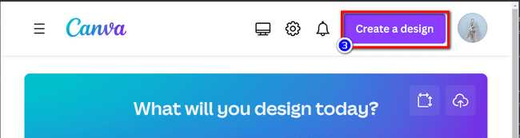
Group 4
Unit 3
07
After a successful login, the 'Create a design' button should be located at the upper right corner of the Canva homepage

Slide 9
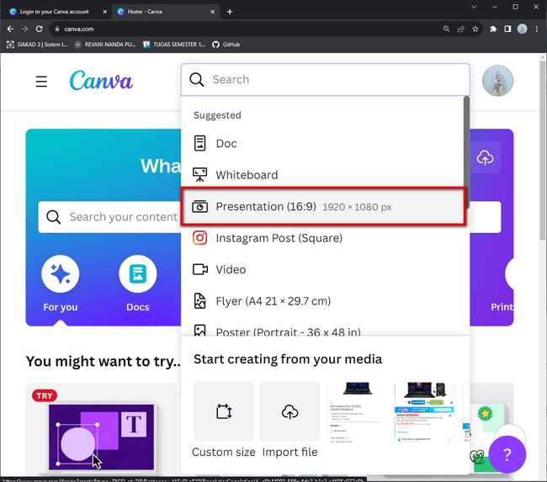
Group 4
Unit 3
08
Then, in the subsequent screen, "Presentation" or "PowerPoint" can be found and selected from the list of available project types.

Slide 10
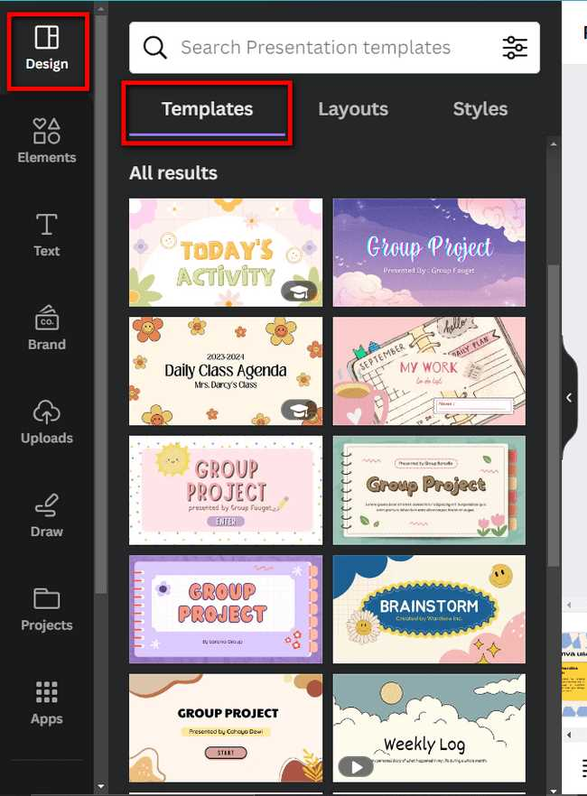
Group 4
Unit 3
09
After opening the new project, a variety of presentation templates will become available for selection. Next, choose one that aligns with your presentation's theme or style, or commence with a 'Blank' option.

Slide 11

Group 4
Unit 3
10
Next, The Canva editor will now become accessible, permitting the editing of each presentation slide. The desired slide can be initiated by a simple click in the bottom panel.

Slide 12
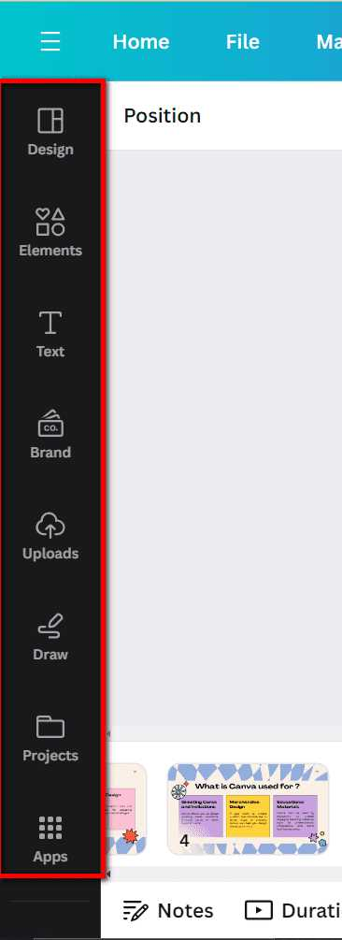
Group 4
Unit 3
11
After gaining access to Canva's platform, the design tools are made available, enabling the addition of text, images, graphics, icons, backgrounds, and other design elements to your slides. This can be effortlessly accomplished through drag-and-drop functionality or by utilizing options on the left side of the screen

Slide 13
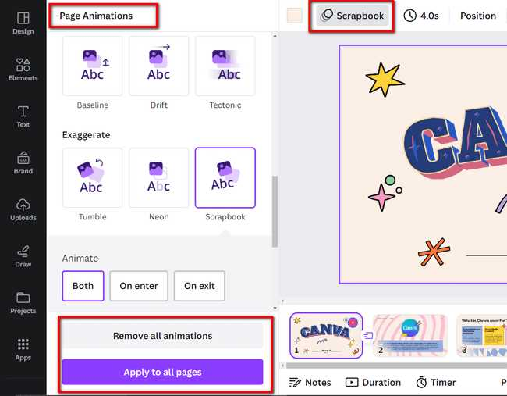
Group 4
Unit 3
12
Then the animation can be introduced to elements on the slides, enhancing the interactivity of the presentation. Elements can be selected, "Animate" can be clicked at the top, and an appropriate animation effect can be chosen.

Slide 14
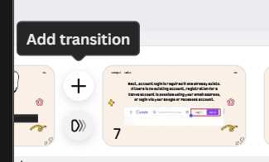
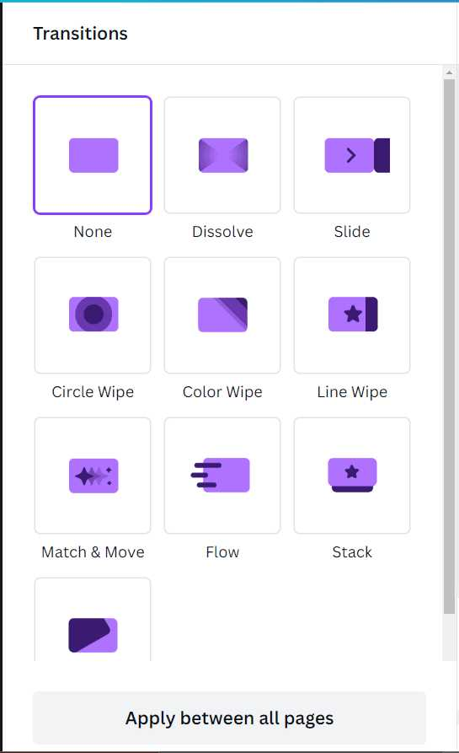
Group 4
Unit 3
13
Next step is adding transitions, transitions between slides are an option. "Transitions" can be selected at the top or between every single slide

Slide 15
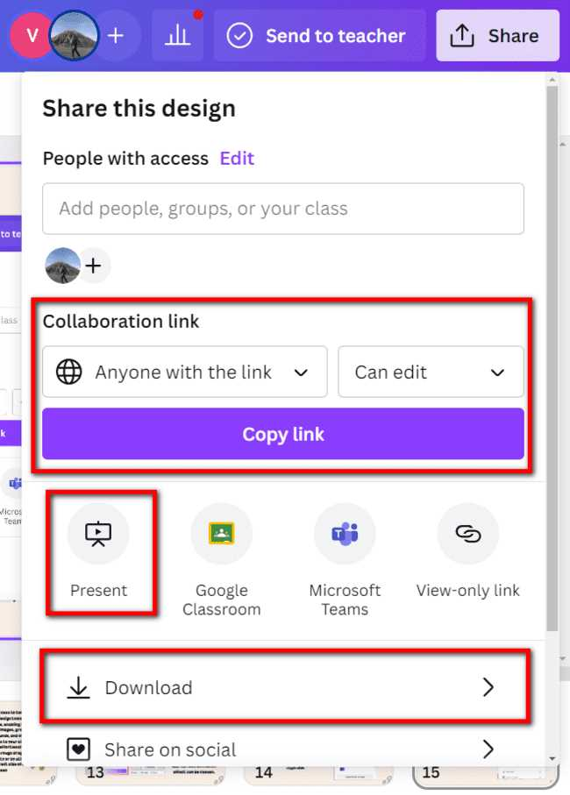
Group 4
Unit 3
14
Finally, the presentation can be saved in PowerPoint format (.pptx) or shared directly via a shareable link by clicking the "Download" or "Present" button.

Slide 16


Group 4
Unit 3
15
Canva is a versatile graphic design and content creation platform that allows users to easily create a wide range of visual content, including social media graphics, presentations, posters, flyers, logos, and more. It offers a user-friendly interface with drag-and-drop functionality, a vast library of templates, images, icons, and fonts, as well as various design tools and features.

Slide 17

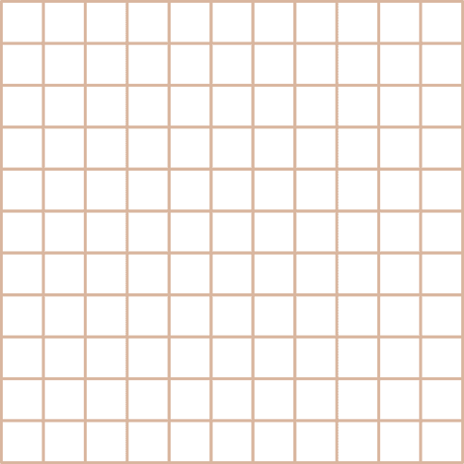





Slide 18


